Slide 1
Fake News Classifier Project

Slide 2
Problem Statement And Understanding
On social networks, the reach and effects of information spread occur at such a fast pace and so amplified that distorted, inaccurate, or false information acquires a tremendous potential to cause real-world impacts, within minutes, for millions of users.
Recently, the number of fake news out in public has increased. Several public concerns about this problem and some approaches to mitigate the problem were expressed. In this problem we are going to try and solve this problem using data science and machine learning.

Slide 3

Exploratory Data Analysis
This is a Binary class classification problem. The target variable contains numeric integers 0(real news) and 1(fake news).
Null Values: There are Null values in the dataset.
Shape: There are 20800 records and 5 features + 1 target variable in the whole data.
The dataset has text features.

Slide 4
Exploratory Data Analysis cont..
The dataset is balanced with good number of samples for the two classes.
The Duplicates are droped from the original dataset. After dropping duplicates, there are 18285 records.
The dataset contains enough balance between the Fake and Real samples.

Slide 5
Data Cleaning
Data Cleaning Approach:
Combined the News headlines, written by information and the news text together.
The combined text is the converted to lowercase.
Email addresses are converted to the text ‘emailaddress’.
Web site links are converted to the text ‘webaddress’
Phone numbers are converted to the text ‘phonenumber’
Currencies are converted to the text ‘currencyamount’
Numbers are converted to the text ‘numbr’.
The non-alphabetic characters are removed from the review texts.
Extra white spaces are removed.
Stop words are removed.
And repeating character patterns are removed.
The cleaned words are then lemmatized.

Slide 6
Text data Encoding
TFIDF was used to encode the text data ‘reviews’
Monograms, bigrams and trigrams are used.

Slide 7
Visualizations

Slide 8
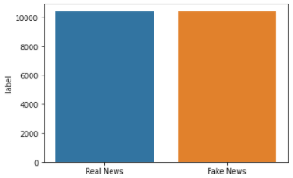
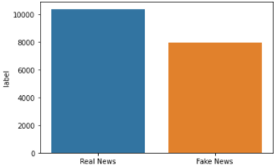
Target variable frequency with missing data(left) vs Target variable frequency without missing data(right)

Slide 9
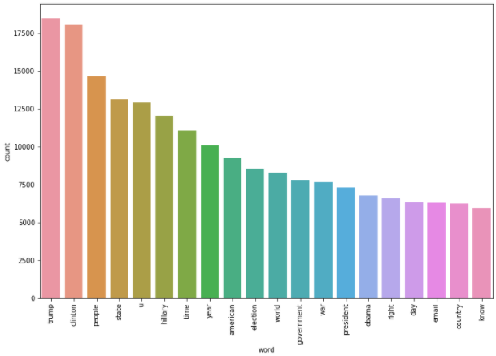

Top words in Fake news samples

Slide 10
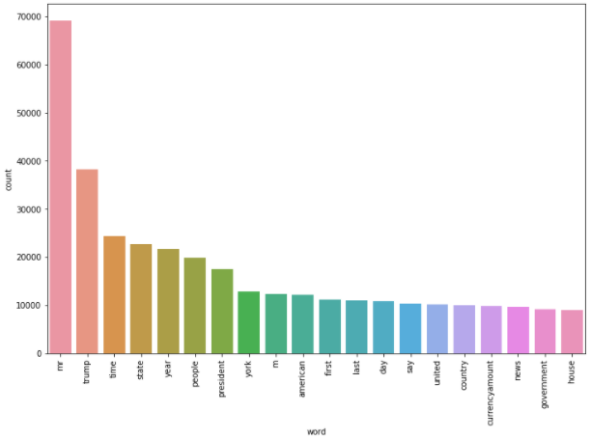
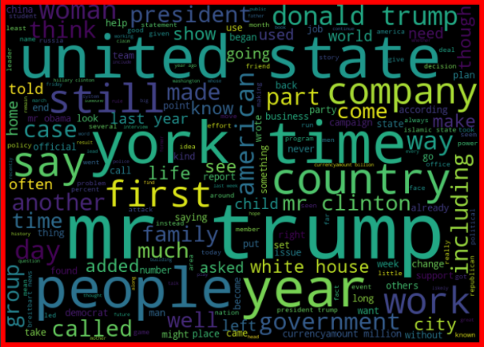
Top words in Real news samples

Slide 11
Steps taken to complete the Project
Performed data cleaning based on NLP approaches.
Lemmatized and Vectorized the text input.
Trained and validated different Machine Learning classification models(base and ensemble models) to select a suitable model.
Chose the final model based on F1 score and Confusion matrix.

Slide 12
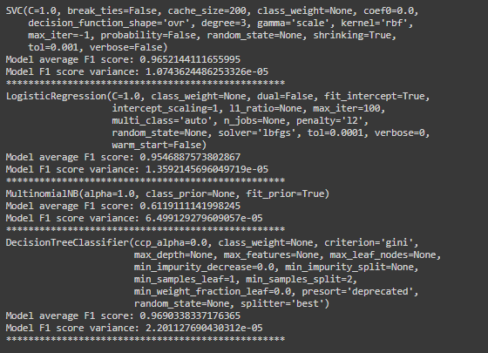
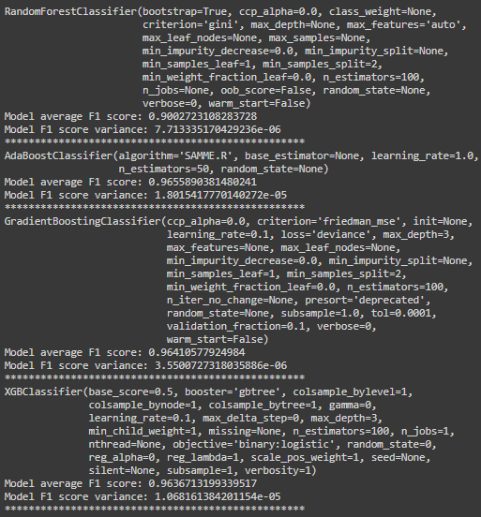
Model score comparison
Simple Models(left) and Ensemble models(right)

Slide 13
Finalized Model
The final model used is AdaBoostClassifier
The tuned hyper parameters used are:
n_estimators = 160,
Learning_rate = 0.5

Slide 14
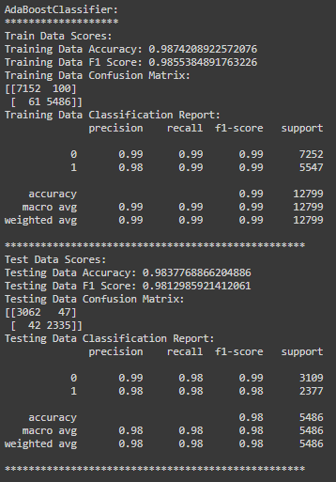
Final Model score

Slide 15
Conclusion
The AdaBoostClassifier is giving a better result than the other algorithms.
The performance shows low bias and low variance.

